Slide 1
DSBA 6100 – Group Project
Worker’s Compensation Claims
Presented by: Moncef El Ouriaghli,
Ngai Tik Chung, Ryan von Trapp,
Sachin Varule and Xinxin Lai

Slide 2

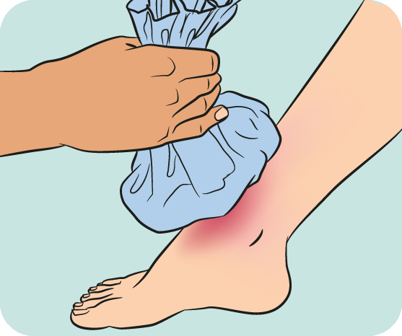

Slide 3
Introduction
Discuss key issues and challenges in claims management process
Initial hypotheses
Tableau visual visualizations
Logistic regression
Strategic recommendations

Slide 4
Key Challenges & Big Data Solutions
Challenges:
Controlling costs
Fraud prevention
Communications
Big Data Analytics:
Predicting which types of injuries may turn into costly cases
Detecting insurance fraud (using past claims and billing)
Classifying employee job by income and level of risk

Slide 5
Visualizations and Insights
Which claims result in the highest cost?
How does litigation affect claims cost?
Where do opportunities exist for reducing claims?
Does the type of injury affect cost?
Which claims are likely to cause fatalities, and how do those affect costs?

Slide 6
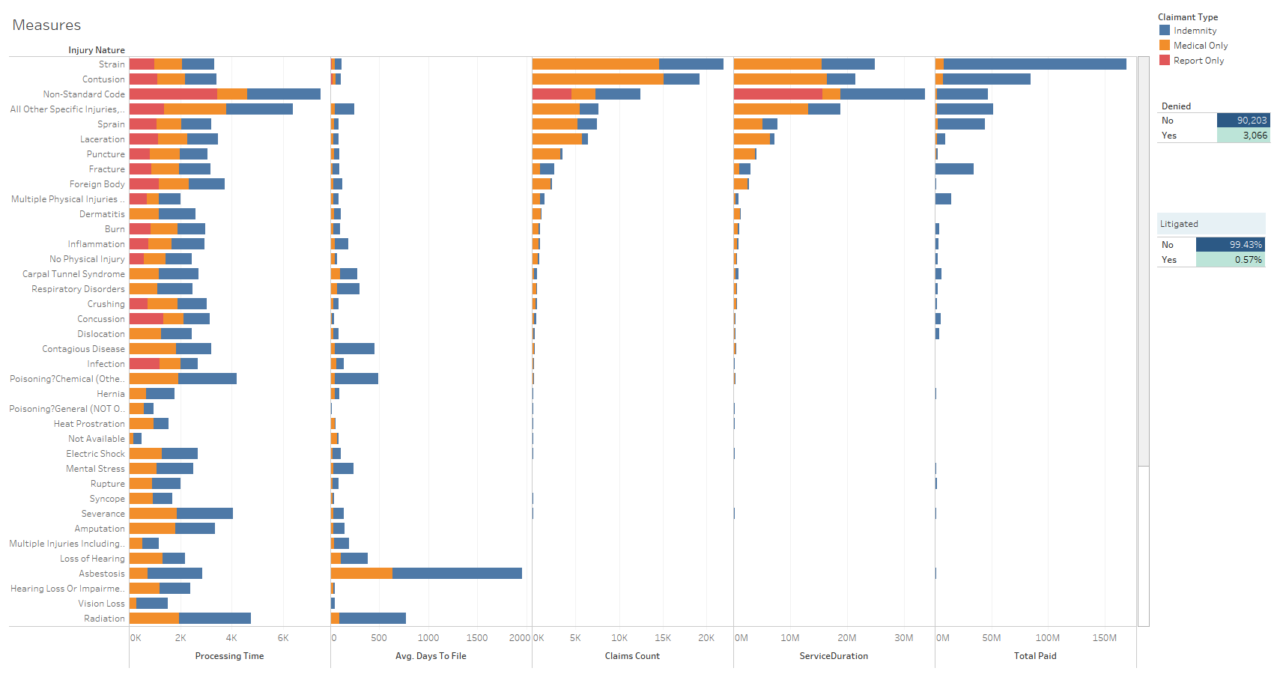
Initial Hypothesis
I) Measures by Injury Nature

Slide 7
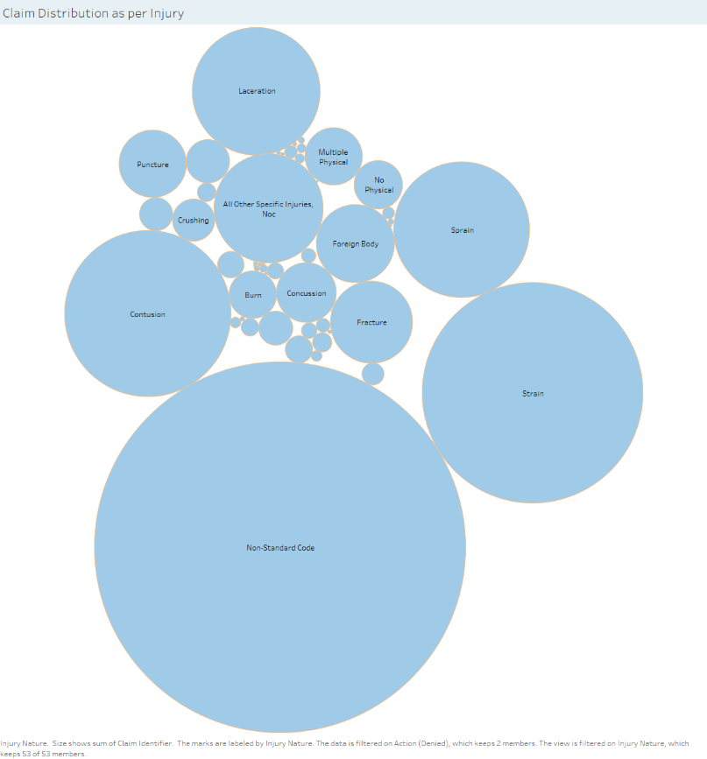

Slide 8
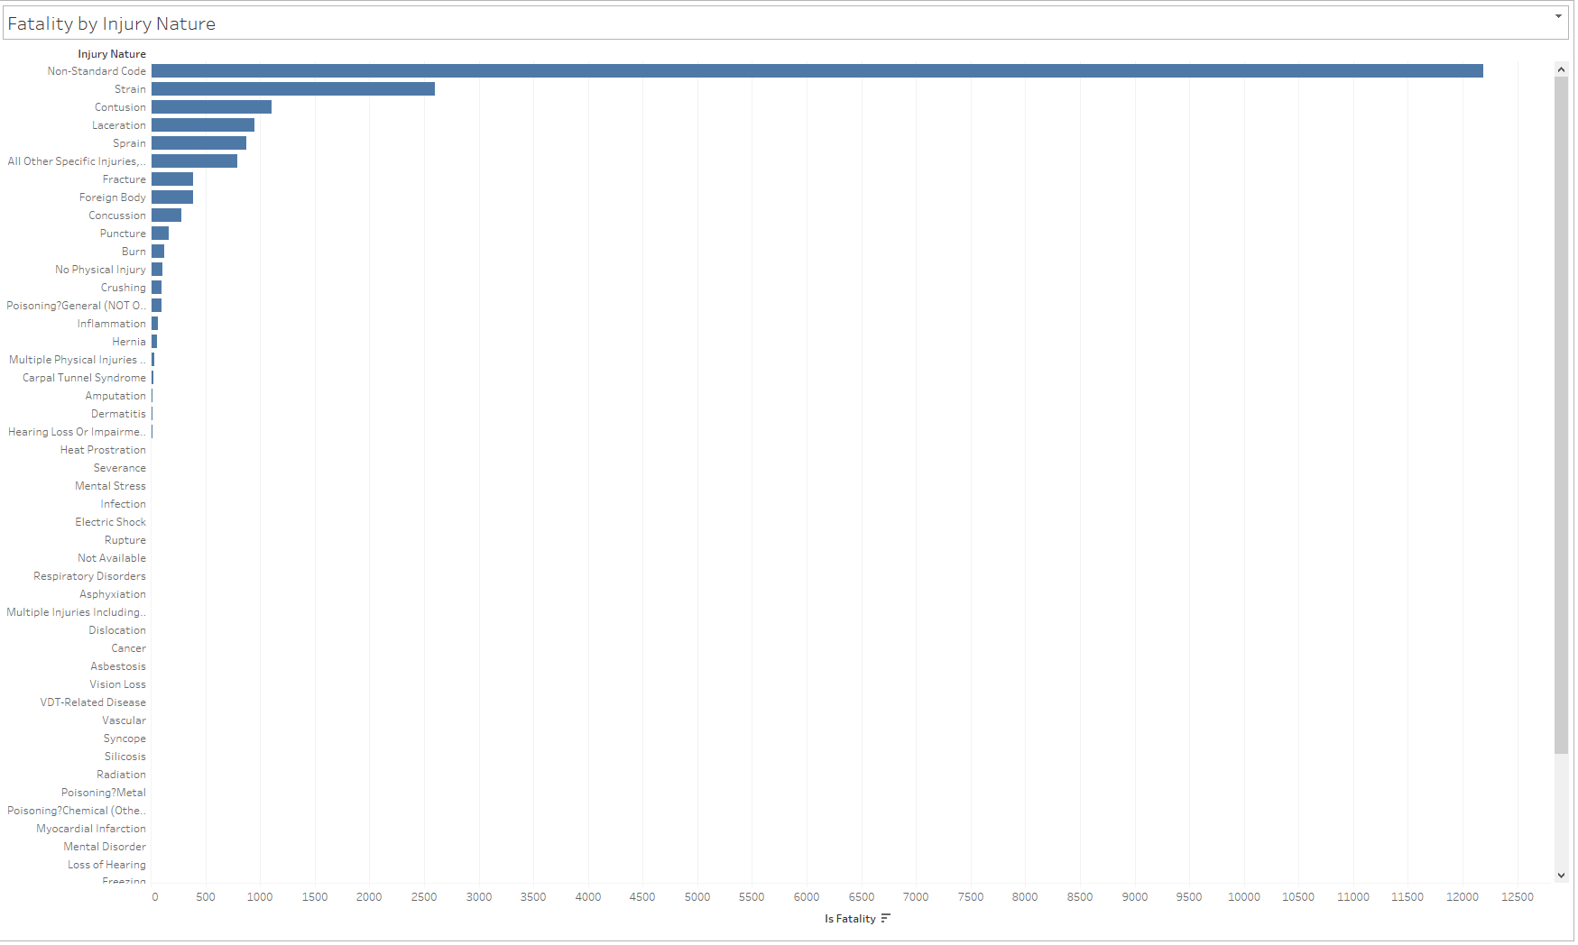

Slide 9
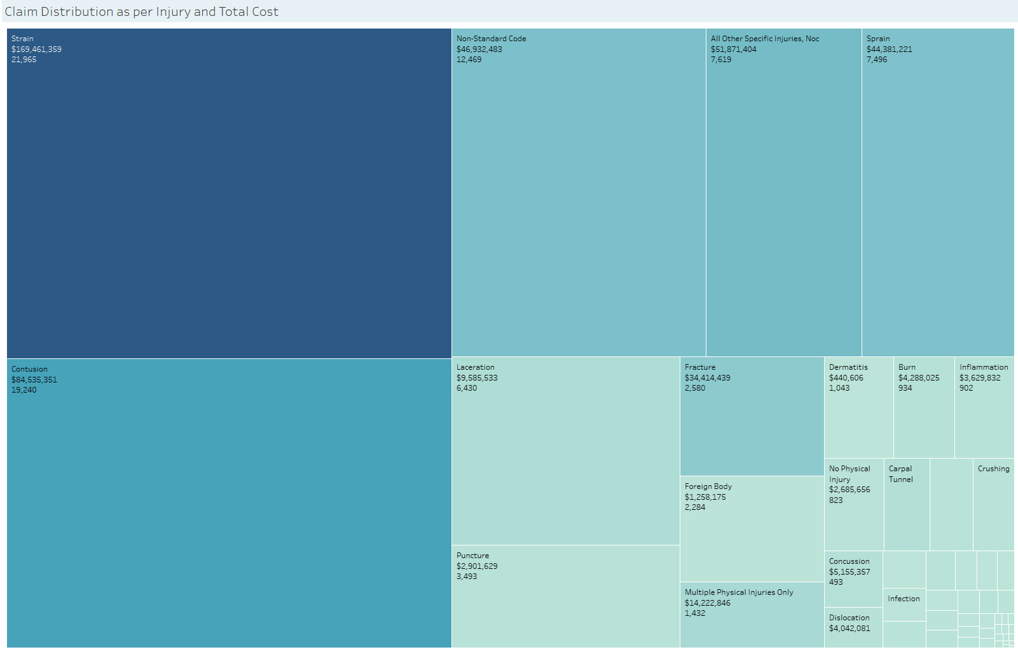

Slide 10
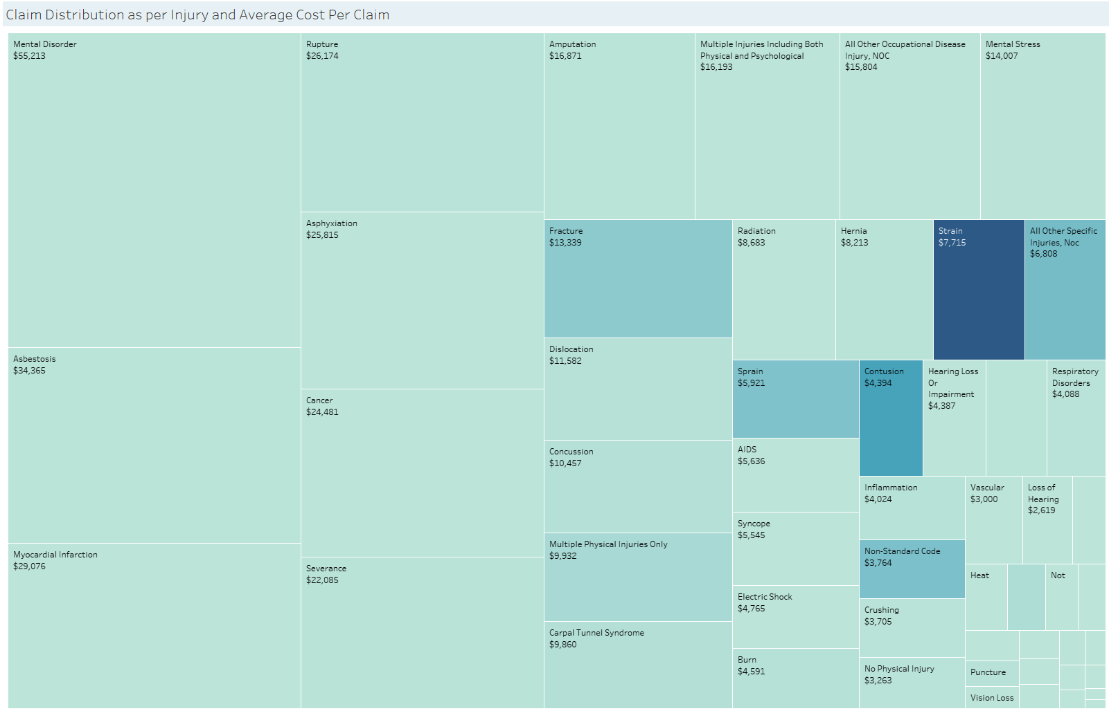

Slide 11
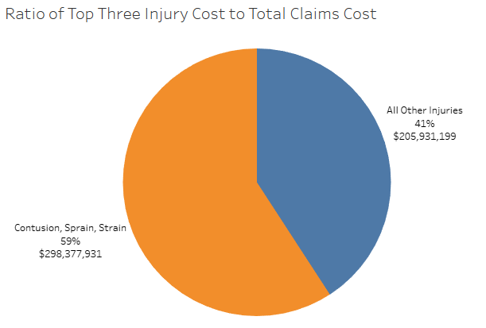

Slide 12
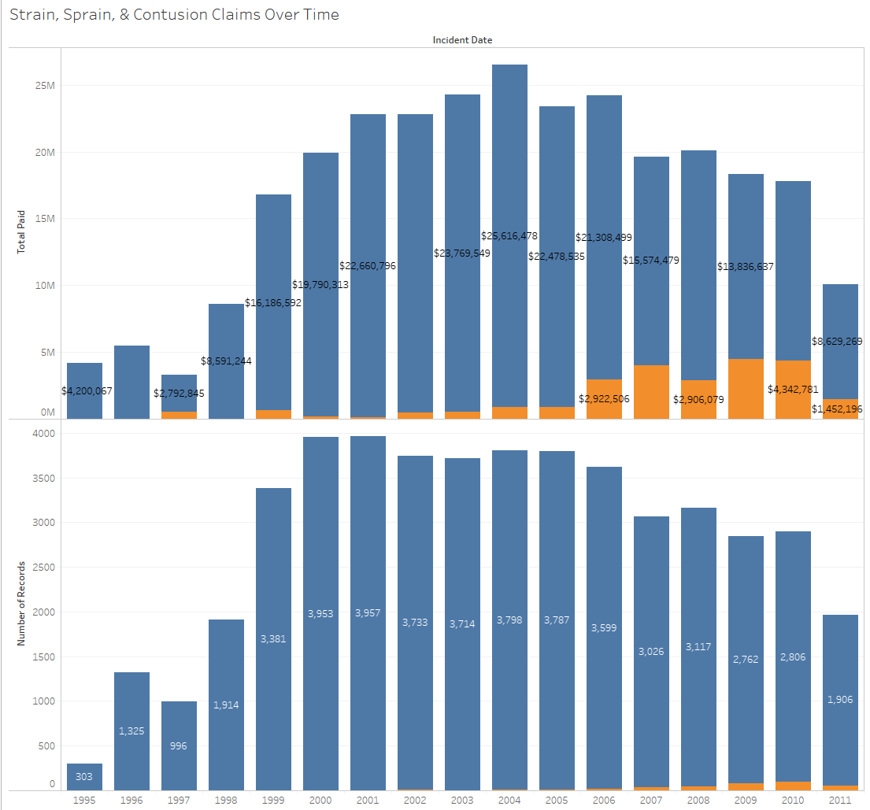


Slide 13
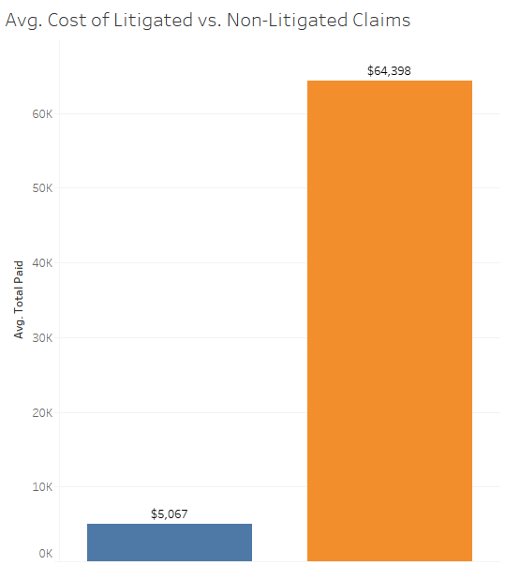
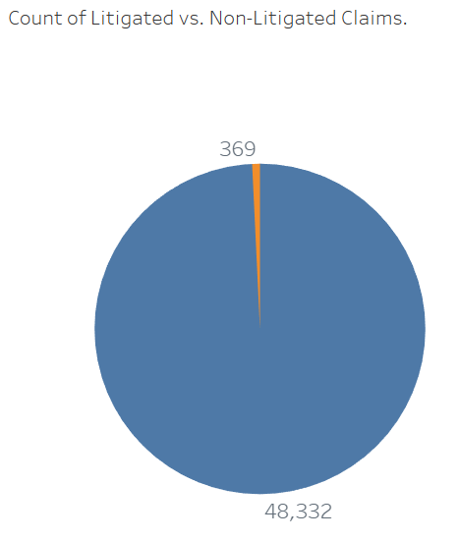

Slide 14
Logistic Regression
Added independent variables for regression test
SUM_of_PaymentAmount: Sum of total payment
ServiceDuration: The duration of the claimant service (ClaimClosedDate - ClaimOpenedDate)
daysToFiles: The duration between the incident date and claimant opened date (ClaimOpenedDate - IncidentDate)
Final Logistic Regression Model
baseline.model <- glm(formula=IsLitigated ~ IsFatality + ClaimantAge_at_DOI_Computed + Gender + ClaimantType + InjuryNature + DaysToFile , family = binomial(link='logit'),data = df.train.Combined)

Slide 15



Results
Accuracy:
$$\frac{TP+TN}{All Cases}=\frac{75,111 +219}{92,075}=81.8\%$$
Predictors | Actual |  | Total
 | Not Litigate | Litigate
Not Litigate | 75,111 (TN) | 48 (FN) | 75,159
Litigate | 16,697 (FP) | 219 (TP) | 16,916
Total | 91,808 | 267 | 92,075
Recall (True Positive Rate):
$$\frac{TP}{TP+FN}=\frac{219}{218+48}=82.0\%$$
Type I Error (False Positive Rate):
$$\frac{FP}{FP+TN}=\frac{16,697}{16,697+75,111}=18.2\%$$

Slide 16
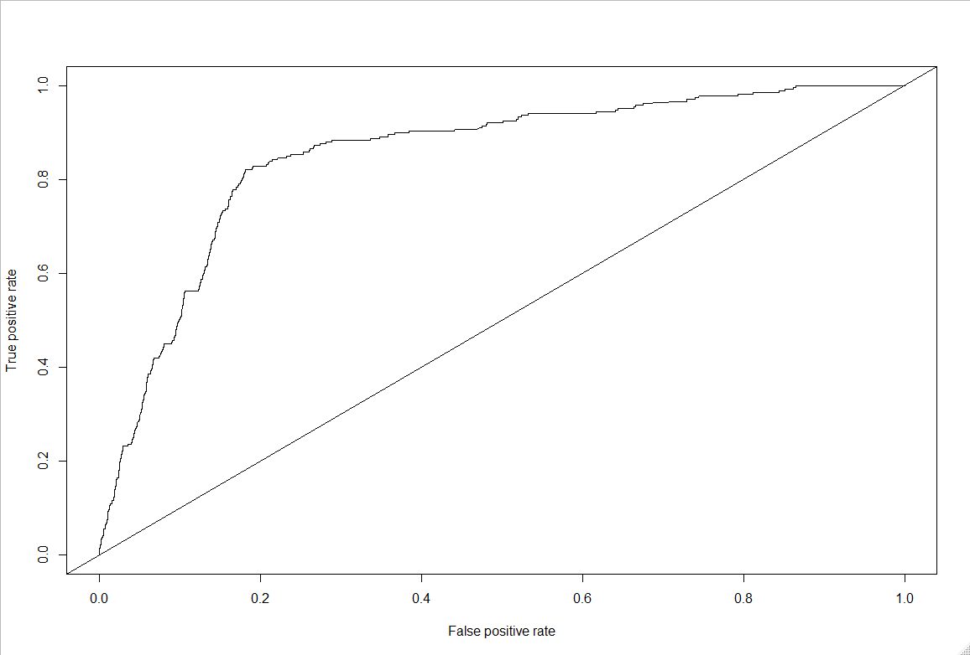
ROC Curve
AUC=0.85

Slide 17
Strategic Recommendations
Focus on reducing the number of claims for high-cost injuries.
Strains, sprains, and contusions are the highest total cost of injuries, and represent 52% of the total claims in the data set.
Use machine learning to predict which cases will be litigated.
Litigated claims are 10 to 20 times the cost of non-litigated claims.

Slide 18

Thank you!
Any Questions?

